Slide 1
WCF Fundamentals
Paul Williams

Slide 2
What is a Service?
In general
In reference to computer software
In Microsoft Windows
To see the list of services in windows, open cmd and enter
sc query type=service

Slide 3
Example 1:
Introduction to WCF
What is WCF?
What is a distributed application
Web
Application
Server
Web
Service
Server

Slide 4
Introduction to WCF
Example 2: An enterprise web application may have the following tiers and each tier may be running on a different machine
Server with
Presentation
Tier
Server with
Business
Tier
Server with
Data Access
Tier

Slide 5
Introduction to WCF
Why build distributed applications?
An enterprise application may need to use the services provided by other enterprises
For better scalability
What is an interoperable application?
What technology choices did we have before WCF to build distributed applications?

Slide 6
Introduction to WCF
Why should we use WCF?
The first client is using a Java application to interact with our service, so for interoperability this client wants messages in XML format and the protocol to be HTTP.
Without WCF:
Client built on any platform
can consume a web service
Java
Web
Application
HTTP Protocol
Dot Net
Web
Service
XML Message Format
XML over HTTP offers
Interoperability

Slide 7
Introduction to WCF
The second client uses .NET and wants messages formatted in Binary over TCP protocol
To satisfy the second client requirement we end up implementing a remoting service.
Web Services and Dot Net Remoting are two different technologies
With Remoting both
Client & Server must be .NET
Client
Windows
Application
TCP Protocol
Dot Net
Remoting
Service
Binary Message Format
Binary over TCP offers
better performance

Slide 8
Introduction to WCF
With WCF
In the endpoint configuration we can specify the protocols and message formats that we want to use.
HTTP Protocol
End
Point
ONE
Java
Web
Application
Dot Not
Remoting
Service
XML Message Format
WCF
Service
TCP Protocol
Client
Windows
Application
End
Point
tWO
Binary Message Format

Slide 9
An Example:
Create a WCF service
Create a WCF host
Specify the configuration
Open the Service Host
Create a Client Application
Configure the Client Application

Slide 10
Features of WCF
Service Orientation
Interoperability
Multiple Message Patterns
Service Metadata
Data Contracts
Security
Multiple Transports and Encodings
Reliable and Queued Messages
Durable Messages
Transactions
AJAX and REST Support
Extensibility

Slide 11
Fundamental WCF Concepts
Communication
Protocols
Message
Patterns
Messaging
Endpoints

Slide 12
Some important WCF Terms
Other concepts and terms used in the WCF documentation include the following:
Message
Service
Endpoint
Address
Binding
Binding element
System-provided bindings
Service operation
Service contract
Operation contract
Data contract
Message contract
Fault contract
Behaviors
Hosting
Self-hosted service
Hosting process
Client application
WCF client
Metadata
Security

Slide 13

THANK YOU

Slide 15
WCF Fundamentals

Slide 16
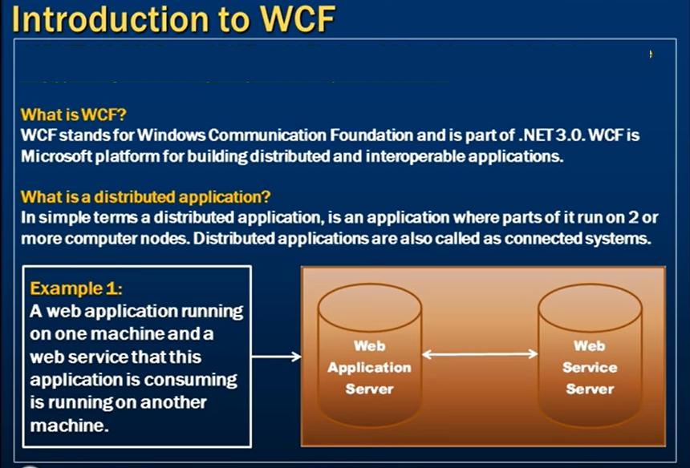

Slide 17
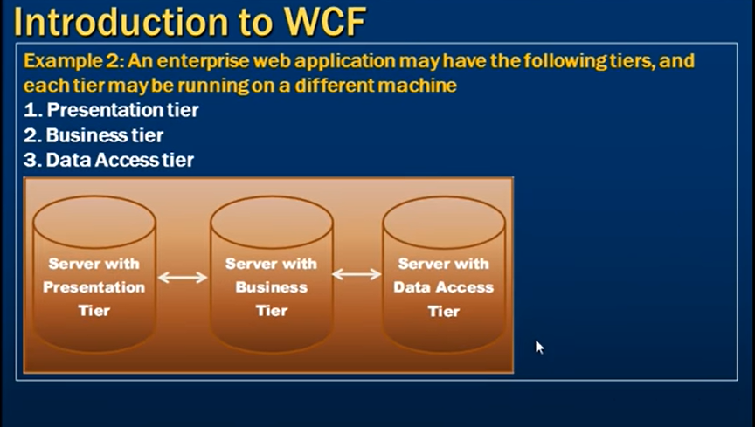

Slide 18
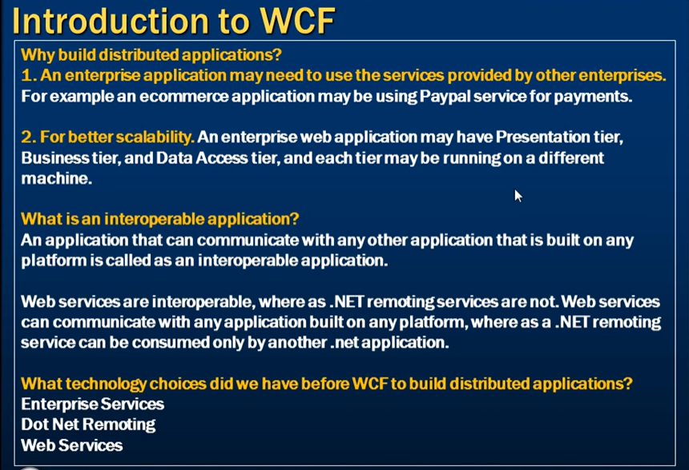

Slide 19
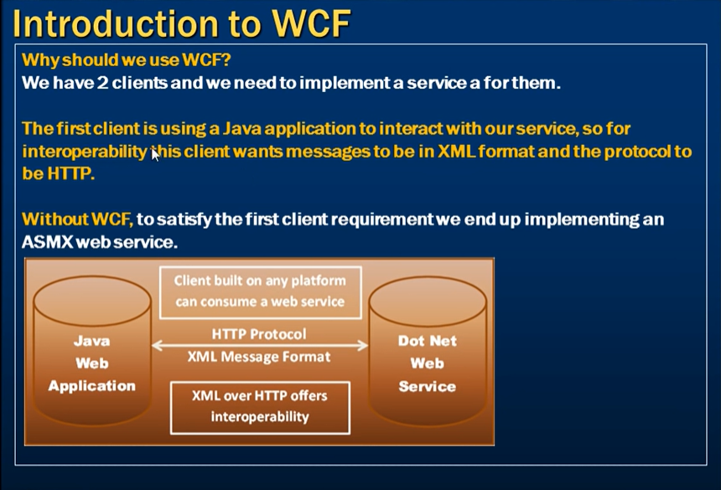

Slide 20
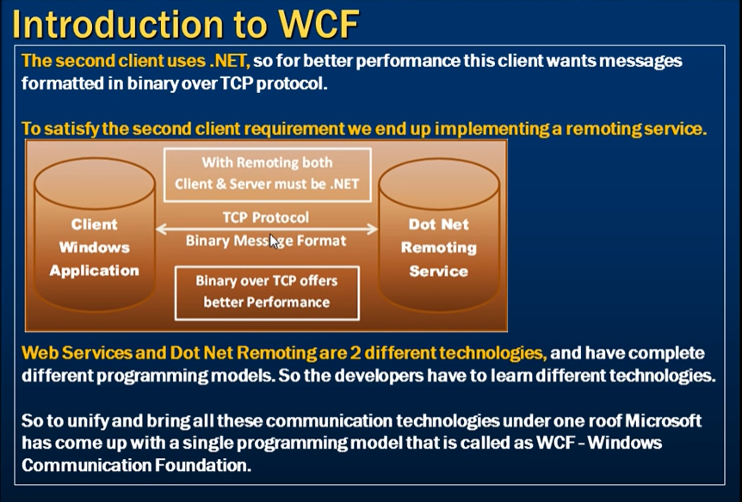

Slide 21
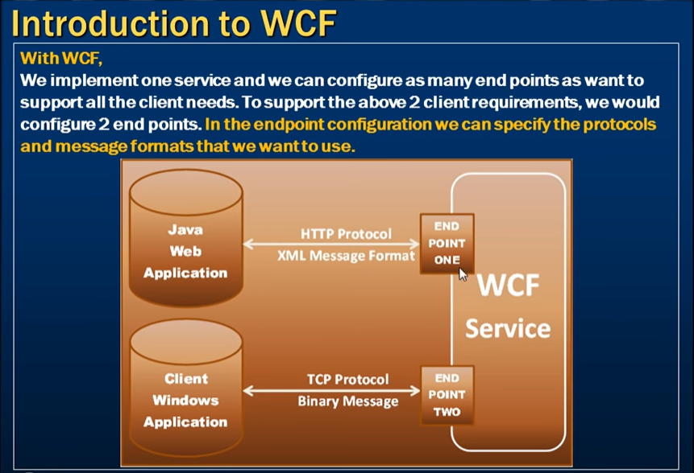

Slide 22
Features of WCF
Service Orientation
WCF enables you to create service oriented applications. Service-oriented architecture (SOA) is the reliance on Web services to send and receive data. The services have the general advantage of being loosely-coupled instead of hard-coded from one application to another. A loosely-coupled relationship implies that any client created on any platform can connect to any service as long as the essential contracts are met.
Interoperability
WCF implements modern industry standards for Web service interoperability.
Multiple Message Patterns
Messages are exchanged in one of several patterns. The most common pattern is the request/reply pattern, where one endpoint requests data from a second endpoint. The second endpoint replies. There are other patterns such as a one-way message in which a single endpoint sends a message without any expectation of a reply. A more complex pattern is the duplex exchange pattern where two endpoints establish a connection and send data back and forth, similar to an instant messaging program.
Service Metadata
WCF supports publishing service metadata using formats specified in industry standards such as WSDL, XML Schema and WS-Policy. This metadata can be used to automatically generate and configure clients for accessing WCF services. Metadata can be published over HTTP and HTTPS or using the Web Service Metadata Exchange standard.
Data Contracts
Because WCF is built using the .NET Framework, it also includes code-friendly methods of supplying the contracts you want to enforce. One of the universal types of contracts is the data contract. In essence, as you code your service using Visual C# or Visual Basic, the easiest way to handle data is by creating classes that represent a data entity with properties that belong to the data entity. WCF includes a comprehensive system for working with data in this easy manner. Once you have created the classes that represent data, your service automatically generates the metadata that allows clients to comply with the data types you have designed.
Security
Messages can be encrypted to protect privacy and you can require users to authenticate themselves before being allowed to receive messages. Security can be implemented using well-known standards such as SSL or WS-SecureConversation.

Slide 23
Features of WCF – Cont.d
Multiple Transports and Encodings
Messages can be sent on any of several built-in transport protocols and encodings. The most common protocol and encoding is to send text encoded SOAP messages using the HyperText Transfer Protocol (HTTP) for use on the World Wide Web. Alternatively, WCF allows you to send messages over TCP, named pipes, or MSMQ. These messages can be encoded as text or using an optimized binary format. Binary data can be sent efficiently using the MTOM standard. If none of the provided transports or encodings suit your needs you can create your own custom transport or encoding.
Reliable and Queued Messages
WCF supports reliable message exchange using reliable sessions implemented over WS-Reliable Messaging and using MSMQ.
Durable Messages
A durable message is one that is never lost due to a disruption in the communication. The messages in a durable message pattern are always saved to a database. If a disruption occurs, the database allows you to resume the message exchange when the connection is restored. You can also create a durable message using the Windows Workflow Foundation (WF).
Transactions
WCF also supports transactions using one of three transaction models: WS-AtomicTransactions, the APIs in the System.Transactions namespace, and Microsoft Distributed Transaction Coordinator.
AJAX and REST Support
REST is an example of an evolving Web 2.0 technology. WCF can be configured to process "plain" XML data that is not wrapped in a SOAP envelope. WCF can also be extended to support specific XML formats, such as ATOM (a popular RSS standard), and even non-XML formats, such as JavaScript Object Notation (JSON).
Extensibility
The WCF architecture has a number of extensibility points. If extra capability is required, there are a number of entry points that allow you to customize the behavior of a service.

Slide 24
Fundamental Windows Communication Foundation Concepts
Messaging
WCF is based on the notion of message-based communication, and anything that can be modeled as a message (for example, an HTTP request or a Message Queuing (also known as MSMQ) message) can be represented in a uniform way in the programming model. This enables a unified API across different transport mechanisms.
The model distinguishes between clients, which are applications that initiate communication, and services, which are applications that wait for clients to communicate with them and respond to that communication. A single application can act as both a client and a service.
Endpoints
Messages are sent between endpoints. Endpoints are places where messages are sent or received (or both), and they define all the information required for the message exchange. A service exposes one or more application endpoints (as well as zero or more infrastructure endpoints), and the client generates an endpoint that is compatible with one of the service's endpoints.
An endpoint describes in a standard-based way where messages should be sent, how they should be sent, and what the messages should look like. A service can expose this information as metadata that clients can process to generate appropriate WCF clients and communication stacks.

Slide 25
Fundamental Windows Communication Foundation Concepts – Cont.d
Communication Protocols
One required element of the communication stack is the transport protocol. Messages can be sent over intranets and the Internet using common transports, such as HTTP and TCP. More transport mechanisms can be added using the built-in extension points of WCF.
Message Patterns
WCF supports several messaging patterns, including request-reply, one-way, and duplex communication. Different transports support different messaging patterns, and thus affect the types of interactions that they support. The WCF APIs and runtime also help you to send messages securely and reliably.

Slide 27
Service End Point
An End point consists of three things, which are A,B,C
Address (Where?)
Binding (how?)
Contract (What?)
Endpoint = A + B+ C
NOT needed

Slide 28
Address
Address is the address of WCF Service, where the Service is hosted? It gives the exact URL of Web Service, where the Service hosts the pattern of URL, which is- Scheme://domain/[:port]/path net.tcp://localhost:1234/MyService http://localhost:1234/MyService Binding
It describes the way or mechanism by which the user will communicate with Web Service. It constitutes some binding element, which creates the structure of communication such as some transport protocols like HTTP, TCP etc. Message format or security techniques etc. Contract
What functionality and operation is being provided by the service is called contract. It specifies what functionality and operations are need to be exposed to the client. It is the interface name which has all operation that need to be exposed. SOAP SOAP stands for Simple Object Access Protocol. It is not a transport protocol but an XML based message protocol.
NOT needed

Slide 29
NOT needed
WCF service
User Defined Pass
Inbuilt Type
How to convert to RESTful.

